Slide 1
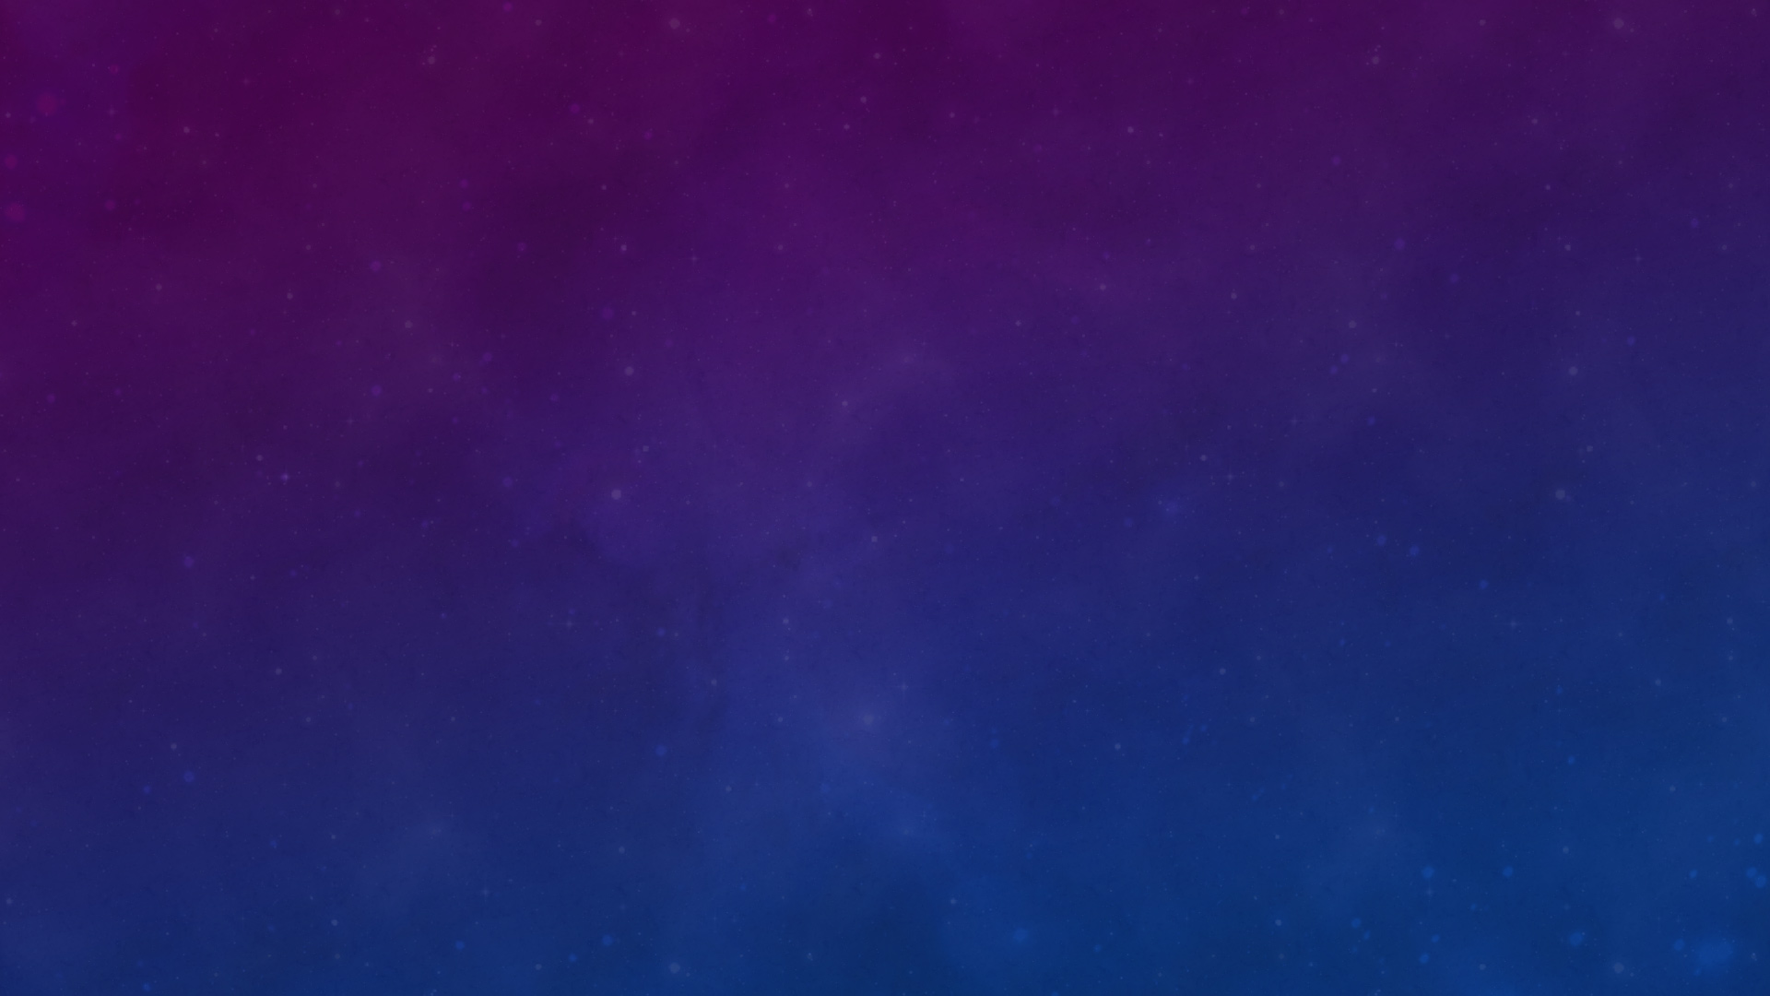

MeD Id
CSN 254
Made By-
Dhruv Shandilya, 20114034
Deepak Tailor, 20114029
Arya Anand, 20114017
Nikhil, 20114063
Nishchay Narayan B, 20114065
Anmol Kumar Varshney, 20114012

Slide 2
Project abstract
Our application assigns a unique medical ID number to all our users, which can be used by medical professionals to get immediate access to medical information in case of any mishap. Further building upon this idea, the user can save medical information such as files and this information can be accessed by software which is exclusively present with hospitals. This will reduce the response time doctors need to read the medical reports and help determine what allergies the patient has, so that he/she can be given quick medical attention accordingly.

Slide 3
What does App Do?
Medical Emergency The app collects information about medical history of patient and ranks the medical reports on the basis of their seriousness
It builds a connection between a doctor and patient by which all the medical reports can be accessed by the registered doctor or any medical institution.
For serious diseases like heart , diabetes, Blood Pressure related problems , lung diseases, liver diseases, kidney diseases, cancer, fatal viral and bacterial diseases the app reminds the patient for regular checkups within a specific time period
The app automatically highlights the allergies that a patient has for example allergy specific chemical compounds used in making medicines.
A lot of people suffer because it takes a very long time to collect various details about medical history
This app contains all the reports which can be easily accessed by medical officers in case of emergency cases like accidents, silent cardiac attacks, asthma etc.
In case of accidents due to blood loss we require blood of particular blood group and it requires up to 15 –20 blood group test
The app by facial recognition/fingerprint recognition gives the details about the patient like his name, age, gender, next of kin and their contact details.
A unique id number will be provided to the user through which he/she can access the medical information at any time.•
Software highlights all the allergies the patient is suffering what medication is to be avoided in case of a particular disease.
The registered doctors can access all the medical details of the patient. They don’t need to conduct test for everything.

Slide 4
Importance of our app
A lot of people suffer because it takes a very long time to collect various details about medical history.
This app contains all the reports which can be easily accessed by medical officers in case of emergency cases like accidents, silent cardiac attacks, asthma etc.
In case of accidents due to blood loss we require blood of particular blood group and it requires up to 15 – 20 blood group test.
The app by facial recognition/fingerprint recognition gives the details about the patient like his name, age, gender, next of kin and their contact details.

Slide 5
Type of model applied
We will choose Iterative Waterfall model.
Reasons to choose this model->
Our software is neither too easy nor complex.
It is well suited for well understood programs. Our goal for making this software is clear.
As our project is small type software, we don’t need any kind of running prototype model.
Our requirements are defined correctly at beginning of the project.

Slide 6
System requirements
Functional Requirements:
Login and sign-up page for the users. There must be separate login options for patients and doctors as the functionality provided varies. After this there should be a display screen of unique ID of the patient so that the patient can see it. After sign up option for patients there should be an OTP verification screen. This should be followed by generating a unique ID for the patient’s medical information which will be displayed on screen too. Then the patient will be asked to fill or update a general questionnaire about general information like their allergy to specific drug and so on and so forth. Finally, after this the patient can upload their medical files onto the application which can be accessed by the doctor in case of emergency.
For the doctor, login will be followed by a welcome page for the doctor. The signup page will be followed by medical verification of the doctor and checking their credentials as a medical practitioner. Finally, this will be followed by a waiting period to verify those credentials and to verify their practitioner license. After the completion of this process, a doctor welcome screen will be displayed, following which doctors can decode the patient's unique ID to access their medical information. Once this is done an alert will go to the patient to curb malpractice or abuse of user’s medical data.

Slide 7
Nonfunctional requirements:
Timing constraint:
The complete project is expected to be completed in 4-5 weeks. We are using the iterative waterfall method, which is an iterative model, we will be delivering the model once for beta testing in 4 weeks. Then everything is integrated and deployed.
Security and Privacy issues:
We are making use of firebase to store the user data and we aim to use encryption to provide the user with security regarding their files, as this is very sensitive information.
Service availability:
Since our development process is done on flutter, we plan to deploy our application on Android, iOS and we aim to create a web application too to deploy the same on the web. This makes sure that we are available to our users on any platform of their choosing.
Software quality attributes:
Our software is designed to look sleek and user friendly and we’ll adopt new design practices, and it will have a graphical user interface, so our users will have ease of use.
Hardware requirements:
Depending on how to generate user ID and whether it is a number or a QR code our user would need a device equipped with a camera to scan the QR code. On the other hand, if it is a number then it can easily be done via web application too.
Performance requirements:
We aim to minimize the response time of our application via effective and efficient code. The code will be quite responsive as it needs to extract data from cloud which can be done asynchronously.

Slide 8
Probable technical requirements
Android studio
Java/Dart/Kotlin
8-16GB RAM
Flutter
AVD
NVIDIA Card

Slide 9
Key Features
MEDICAL EMERGENCY APP
GENERATES UNIQUE IDENTIFICATION NUMBER
PATIENT CAN UPLOAD ALL HIS PREVIOUS RECORDS
IT HIGHLIGHTS THE ALLERGIES
DOCTOR’S PRESCRIPTION IS AVAILABLE ONLINE

Slide 10
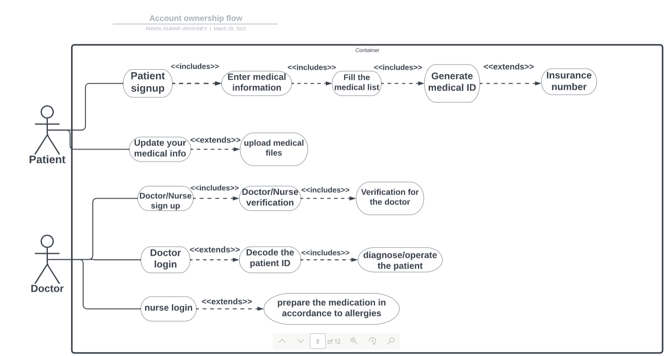
Use case diagram

Slide 11
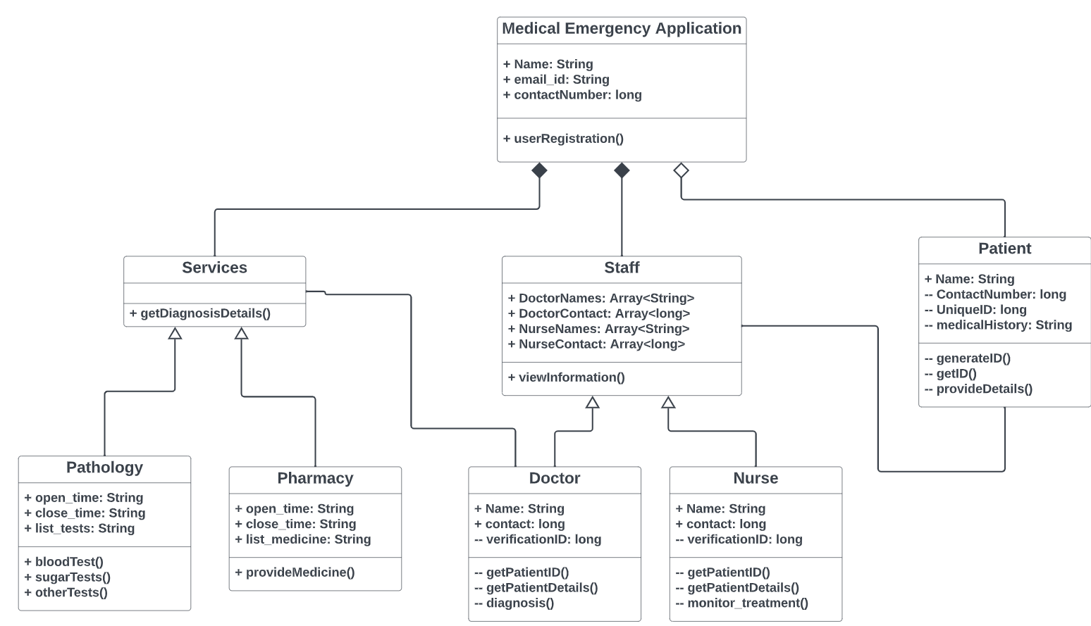
Class Diagram

Slide 12
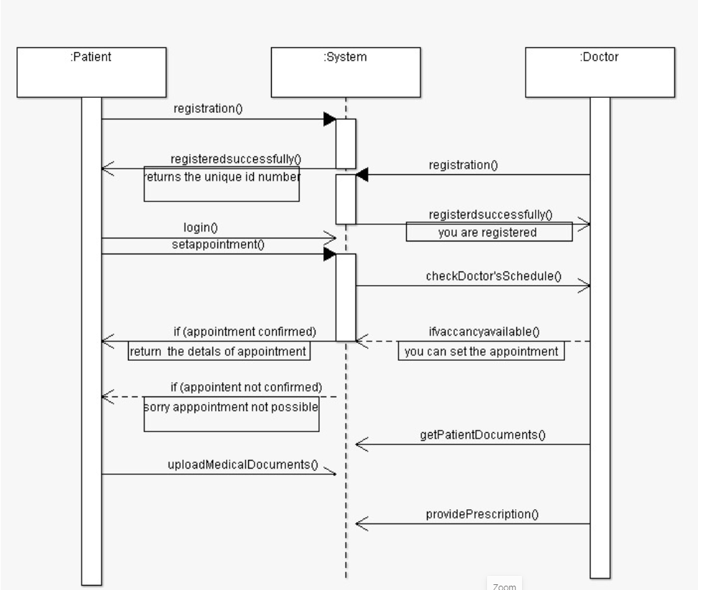
Sequence diagram

Slide 13
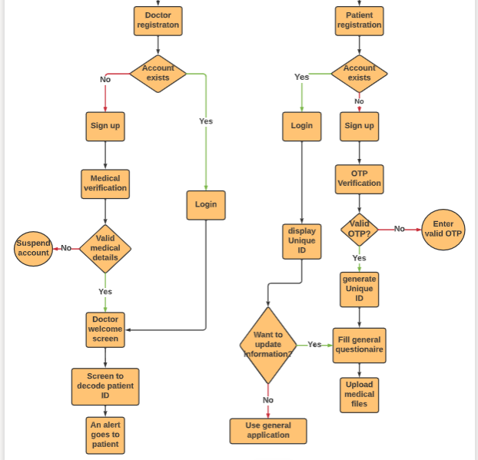
Flowchart diagram

Slide 14
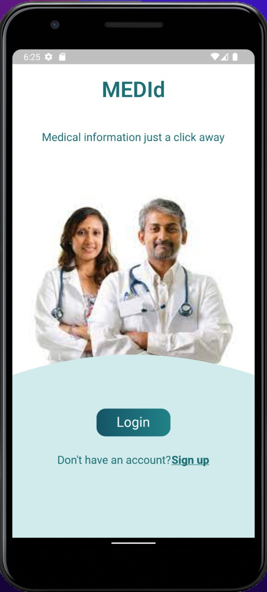
Home page

Slide 15
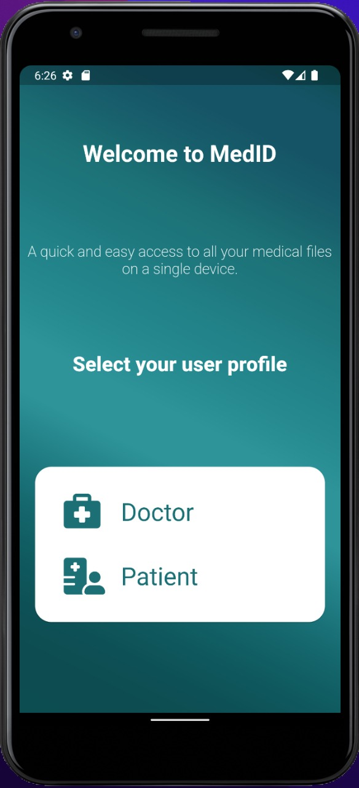
Select user profile page

Slide 16
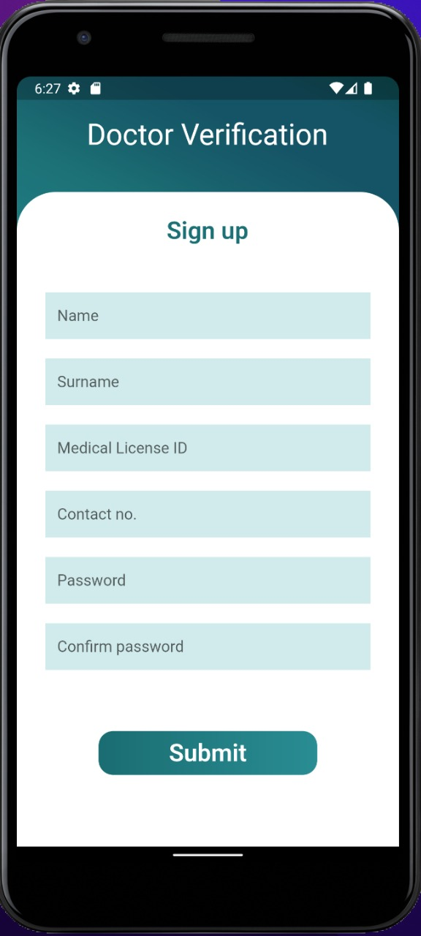
Doctor’s verification

Slide 17
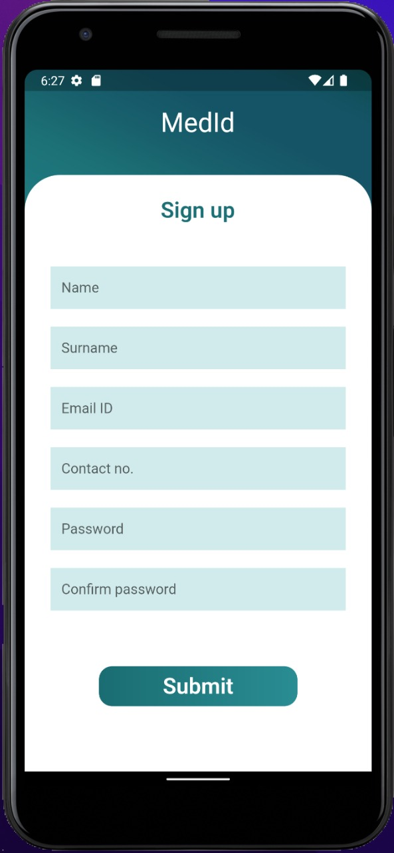
Patient sign-up page

Slide 18

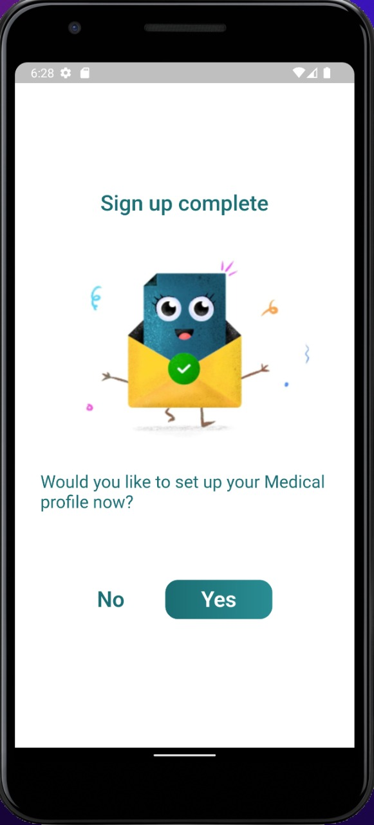
Sign-in complete page

Slide 19
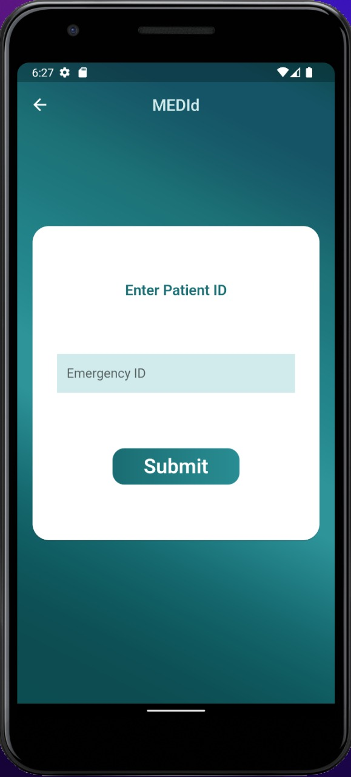
Doctor Access page

Slide 20
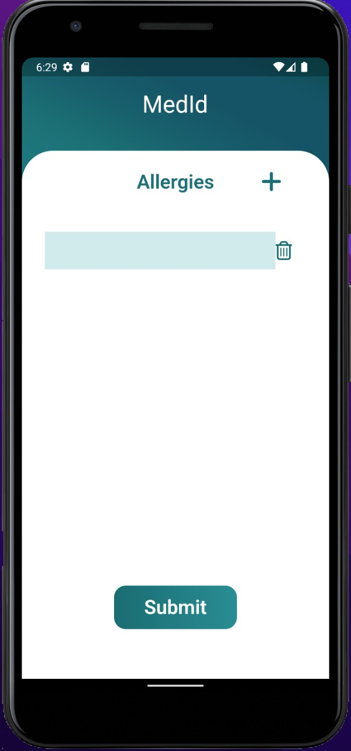
Allergies Page

Slide 21
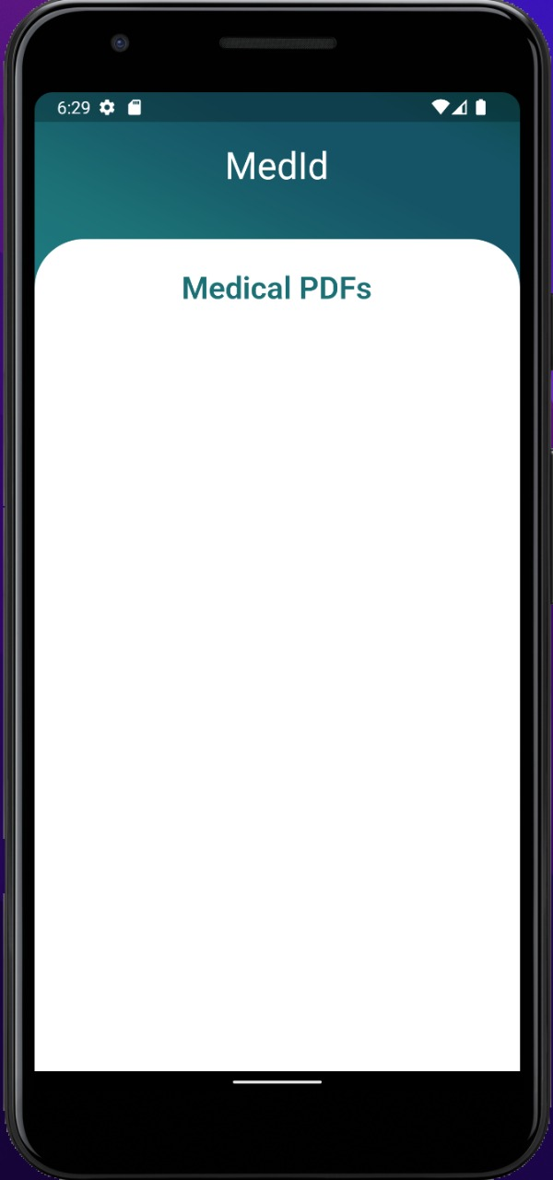
Uploading medical history files page

Slide 22


